Slide 1

Basic Details of the Team and Problem Statement
Ministry/Organization Name/Student Innovation:
SMART INDIA HACKATHON 2022
PS Code: DA1065
Problem Statement Title: SOLAR PANEL WITH SOLAR TRACKING DEVICE WITHOUT POWER CONSUMPTION
Team Name: HELIOTROPICS
Team Leader Name: J SAI MALLIK YADAV
Institute Code: C-19793
Institute Name: MAHATMA GANDHI INSTITUTE OF TECHNOLOGY
Theme Name: RENEWABLE/SUSTAINABLE ENERGY

Slide 2
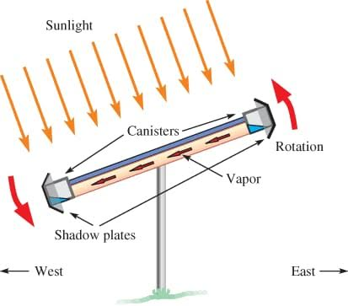
Idea/Approach Details
Idea/Solution/Prototype :
Solar Energy is the best renewable energy source, which is widely being used.
So it is the need of the hour to improve the efficiency of solar power generation.
As we know that solar energy produced will be maximum when solar panel’s surface is directly perpendicular to the incident sun rays.
Thus we need a tracking mechanism to make solar panels always face the sun to capture maximum power.
This action is called HELIOTROPISM.
Here we use the principle of Differential Pressure Controlled system, to achieve Heliotropism.
Technology stack :
Here we use PASSIVE TRACKING technology to increase effectiveness of power generation.
Components used :
Solar panels
Refrigerant: R-134a
Aluminium Canisters
Copper tube
Frame(stand)

Slide 3
Idea/Approach Details
Use Cases :
Dependencies / Show stopper :
This passive solar tracking technology is used to provide maximum power generation without consumption of electrical energy. And using of complex electronic components and circuitry.
The design is robust, easy to construct, doesn’t require a skilled person to construct & assemble.
The climate has to be sunny.
Here the entire tracking system depends on the refrigerant fluid (r-134a) which is the working element.
This element is used to create a tilting effect to track the sun.
The panel tilts according to the direction of sunlight due to gravity.
This mechanism enables maximum power generation.

Slide 4
Team Member Details
Team Leader Name: J SAI MALLIK YADAV
Branch (Btech/Mtech/PhD etc): Btech Stream (ECE, CSE etc): ECE Year (I,II,III,IV): III
Team Member 1 Name: G TEJASHWINI
Branch (Btech/Mtech/PhD etc): Btech Stream (ECE, CSE etc): ECE Year (I,II,III,IV): III
Team Member 2 Name: M VINAY
Branch (Btech/Mtech/PhD etc): Btech Stream (ECE, CSE etc): ECE Year (I,II,III,IV): III
Team Member 3 Name: G AMARNATH
Branch (Btech/Mtech/PhD etc): Btech Stream (ECE, CSE etc): ECE Year (I,II,III,IV): III
Team Member 4 Name: D TEJA VARDHAN REDDY
Branch (Btech/Mtech/PhD etc): Btech Stream (ECE, CSE etc): ECE Year (I,II,III,IV): III
Team Member 5 Name: V REEMA RANI
Branch (Btech/Mtech/PhD etc): Btech Stream (ECE, CSE etc): ECE Year (I,II,III,IV): III
Team Mentor 1 Name: K.BAPAYYA
Category (Academic/Industry): Expertise (AI/ML/Blockchain etc): Domain Experience (in years):
Team Mentor 2 Name:
Category (Academic/Industry): Expertise (AI/ML/Blockchain etc): Domain Experience (in years):

